Slide 1
Nutrition 101
Understanding the Basics of Food
Notes:
Hi Class, Welcome to Sports Nutrition, My name is Renata Korczak, please feel free to call me Renee, and I’ll be your instructor for this course. This is the very first lecture for our class and it is titled “Nutrition 101, Understanding the Basics of Food”. I created this lecture to provide each of you with some nutrition basics and a foundation for this course, before we jump into sports nutrition specific topics. This lecture does not correspond to a chapter in your book, so please listen carefully and let’s get started.

Slide 2
Objectives
Define
Describe the main functions of carbohydrates, protein, fat, vitamins, minerals, and water
Identify and apply the physiological fuel value of carbohydrates, protein, and fat
List foods that are sources of carbohydrates, protein, and fat
Nutrition Carbohydrates Proteins Lipids | Vitamins Minerals Water

Slide 3
What is Nutrition?
Notes:
Why do we study it and why do we care?

Slide 4

What is a nutrient?
What qualifies as an essential nutrient?
Notes:
Food provides the nutrients needed to fuel, build, and maintain all body cells

Slide 5

Essential nutrients in the human diet
Energy-Yielding Nutrients (kcal)
Non- Energy Yielding Nutrients

Slide 6
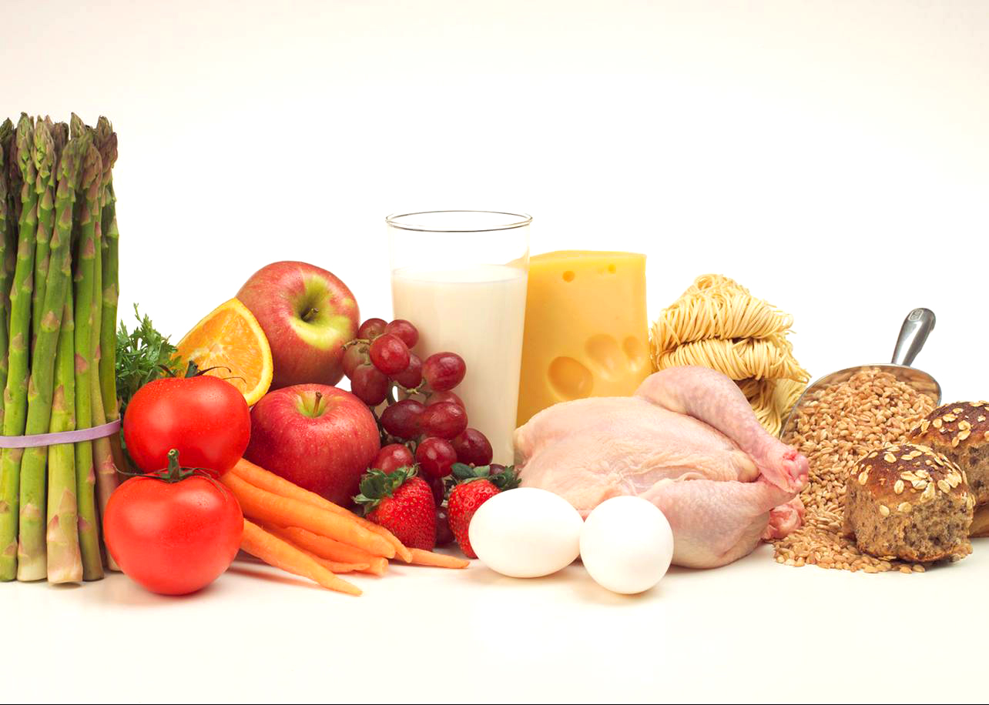
Macronutrients are needed in larger amounts in the diet, while micronutrients are needed in smaller amounts
Macronutrients
Micronutrients

Slide 7
Carbohydrates

Slide 8
Carbohydrates
Composed of
Main function
Classified as
Notes:
Composed of carbon, hydrogen and oxygen
Provide 4 calories per gram (4 kcal/g)
Main function is to provide energy in the form of glucose
Classified as simple or complex
Simple carbohydrates include disaccharides and monosaccharides
Complex carbohydrates include fiber and starch

Slide 9
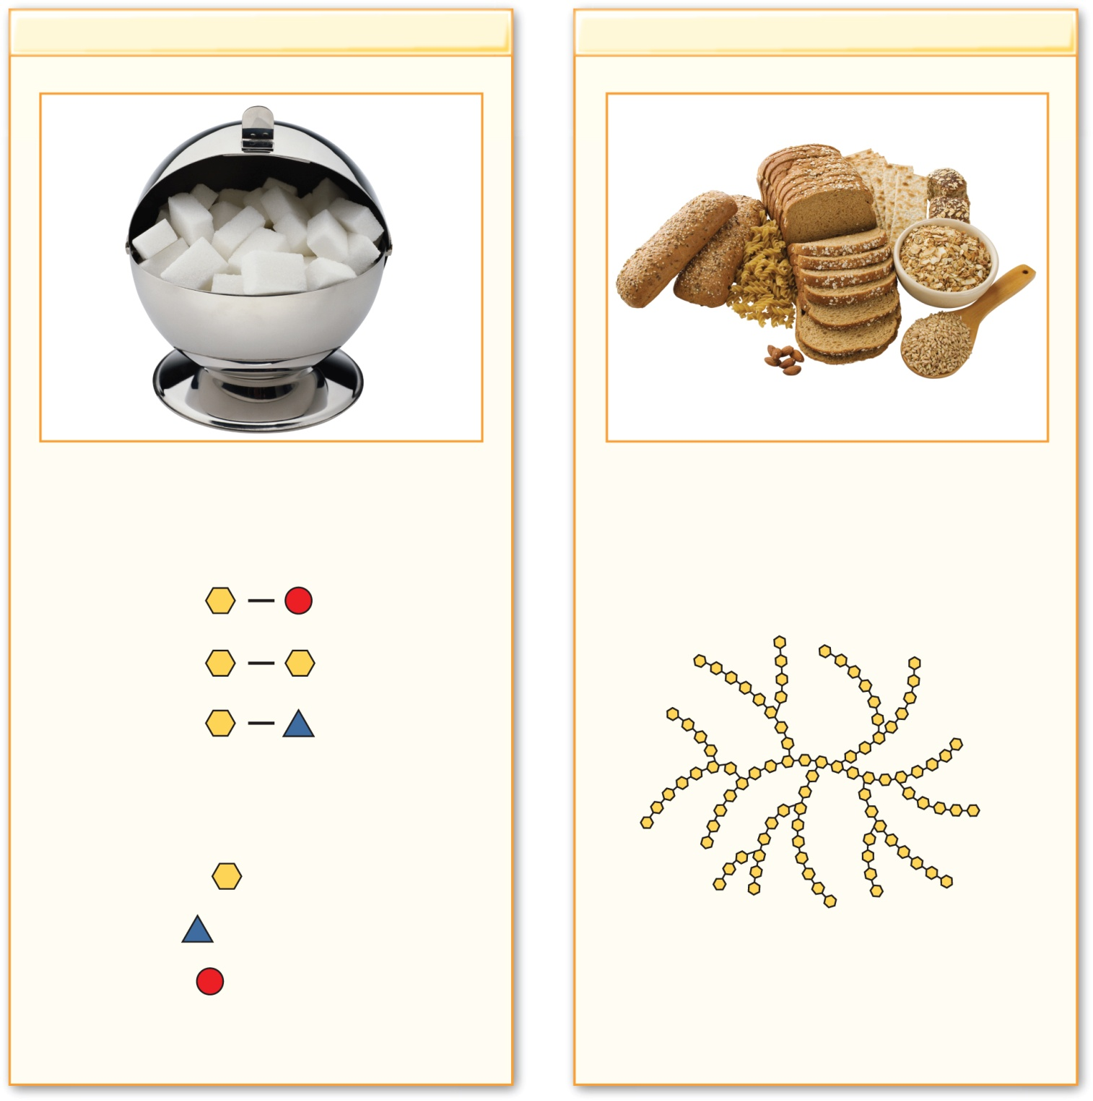
Copyright © McGraw-Hill Education. Permission required for reproduction or display.
Simple Carbohydrates
Complex Carbohydrates
Sugar
Readily usable form of carbohydrates
Starch
Storage form of carbohydrate in foods
Fiber
Indigestible carbohydrate that forms structure
of plant cell walls
The simple sugars are represented by the
yellow hexagons (glucose),
blue triangles (fructose),
The yellow hexagons represent the glucose
molecules that make up starch and fiber.
As you’ll see in Chapter 5, starch and fiber
differ in the way the glucose molecules are
linked together.
and red circles (galactose).
(sugar): ©PhotoDisc/PunchStock RF; (starch): ©Tetra Images/Getty Images RF

Slide 10
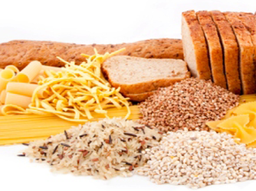
Food sources of carbohydrates

Slide 11
Protein

Slide 12
Protein
Composed of
Main Functions

Slide 13
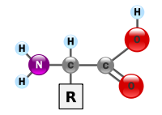
Example of an Amino Acid
Amine Group
Carboxylic Acid Group

Slide 14
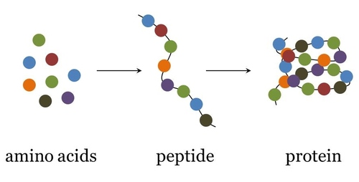
The body needs 20 different amino acids to function
20 amino acids in total

Slide 15
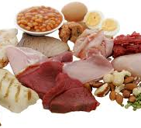
Food sources of protein

Slide 16
Fat

Slide 17
Fat (the basics)
Main Functions

Slide 18
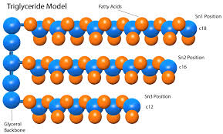
Fats (the basics), triglycerides
Triglycerides

Slide 19
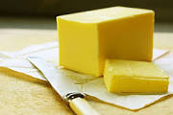
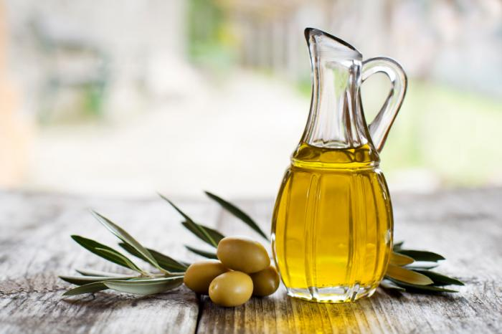
Fat (the basics), types of
Saturated fat:
Unsaturated fat:

Slide 20
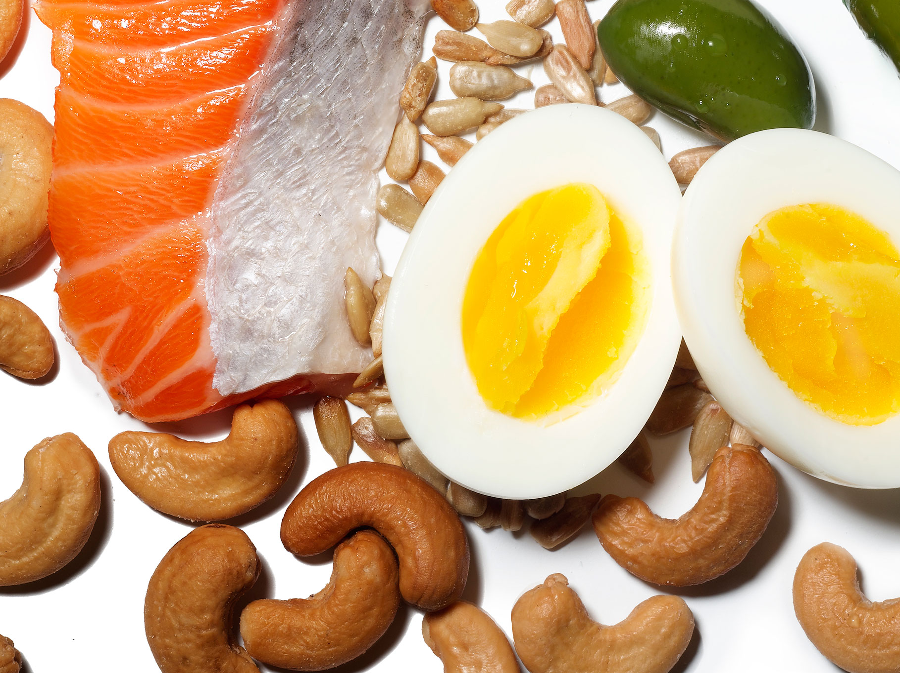
Food sources of fat

Slide 21
Vitamins
Definition

Slide 22
Classes of Vitamins
Fat soluble
Water soluble

Slide 23
Minerals
Definition

Slide 24
Minerals
Minerals CANNOT be made in the body
Types of minerals
Major minerals
Trace minerals

Slide 25

Water
Water is often overlooked as a nutrient, but we need more water than any other nutrient.
Main Functions

Slide 26
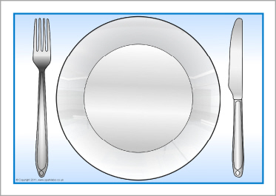
Practice problem
Build a meal that includes at least 1 food from each of the main macronutrients (carbohydrates, protein, fat)

